Slide 1

case study on Exploratory data analysis of Brazil housing
Mentored by – Jaya Pandey
Presented By- Pushkar Hedau

Slide 2
INTRODUCTION
Castro Brazilia Inc. , a real estate management firm wishes to help people to relocate to other cities as work from home is allowed to 40% of the work force. Since cities like sau paulo and rio-de-janerio are expensive , we will analyize the data for suitalble relocation for 3 categories of people.
Bachelors
Mid-size-family
Large Family

Slide 3
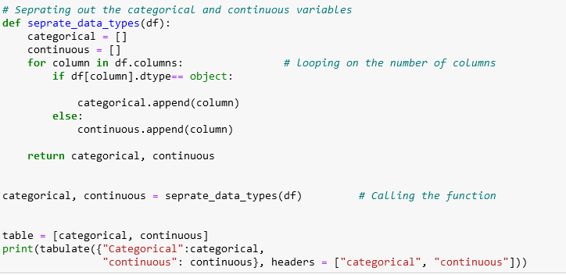
Separating the categorical and numerical columns

Slide 4
SEPARATE CATEGORICAL AND NUMERICAL COLUMNS
CATEGORICAL
CITY
ANIMAL
FURINITURE
NUMERICAL
ROOMS
BATHROOM
PARKING SPACES
FLOOR
HOA (R$)
RENT AMOUNT (R$)
PROPERTY TAX (R$)
FIRE INSURANCE (R$)
TOTAL (R$

Slide 5
CRITERIA
1. Bachelors---no of rooms will be less than 2 with single bathroom and we can see for both furnished and non furnished homes.
2. Mid-size family--- no of rooms will be less than equal to 6, with 2-3 bathrooms, parking spaces .
3. For larger families---- no of rooms must be greater than 6 ,with greater than 3 bathrooms and parking spaces .

Slide 6
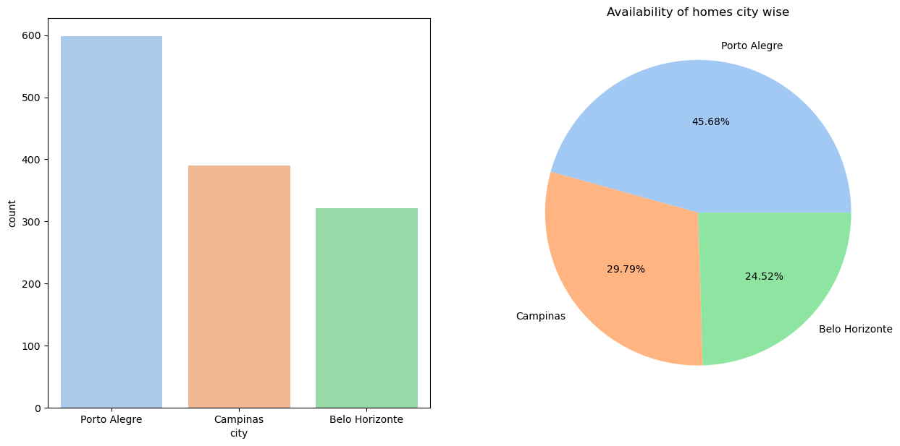
Availability of homes city wise for bachelors
Interpretation---
On the basis of availability of homes Porto Alegre city can be chosen for relocation.

Slide 7
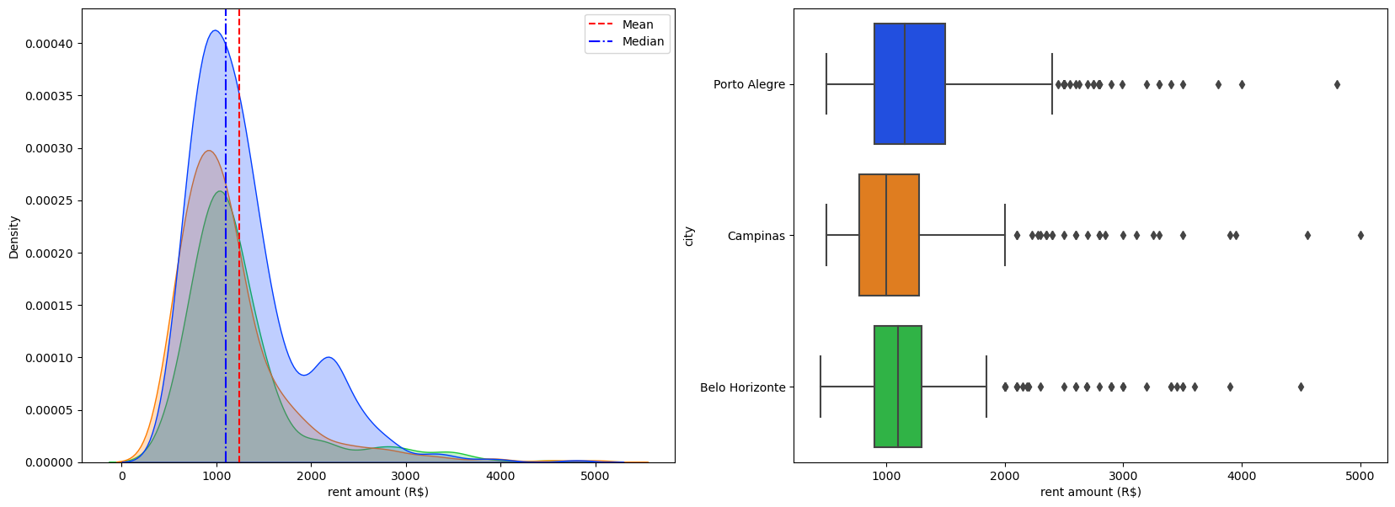
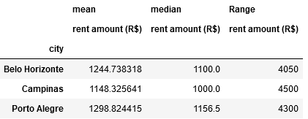
Interpretation----
Since mean >median , the data is positively skewed.
Positively Skewed means majority of the data is concerntrated on the lower end of the range and higher value of mean is due to the presence of outliers in the data .
Outlier removal is not advised as the rent of property may differ on the basis of furniture and location .
On the basis of rent amount campinas city is more preferred as compared to other cities.

Slide 8
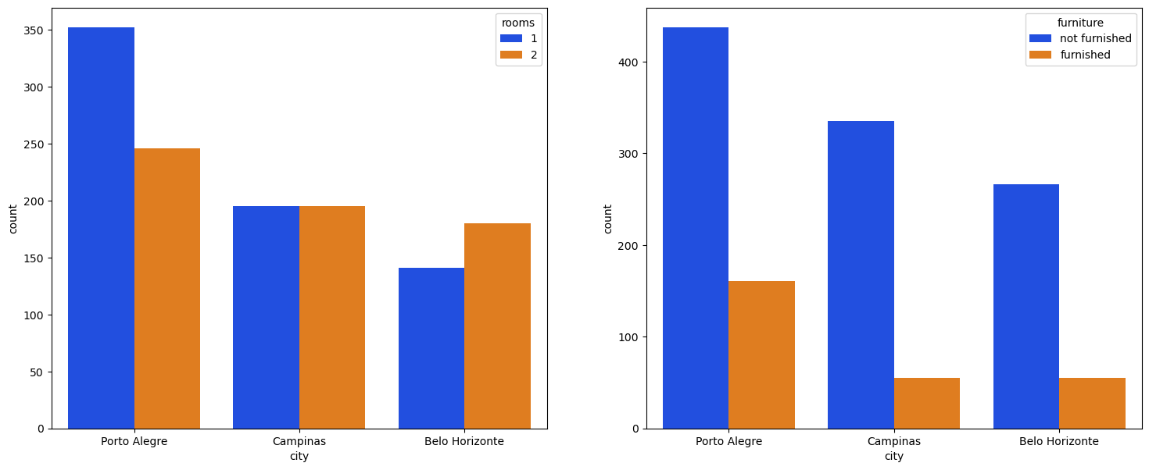
Interpretation---
For bachelors more single rooms are available in porto alegre city
Majority of rooms are non-furnished in the porto alegre city .
Conclusion ---
On the basis of availability of rooms and since there is not much difference in the rent of cities , Porto Alegre city will be suitable for bachelors to relocate.

Slide 9
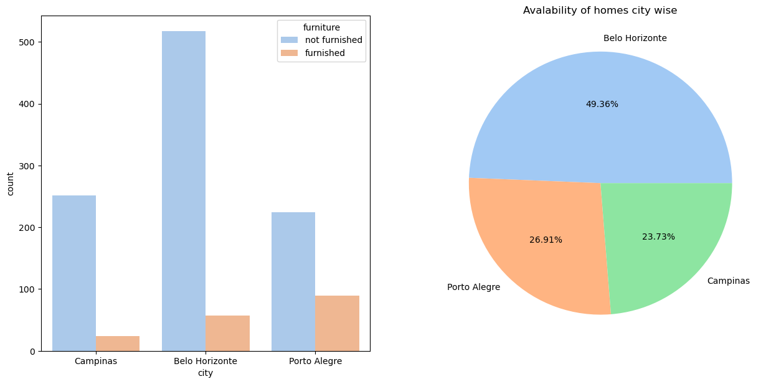
Availability Of Homes For Mid-size Family
Interpretation----
On the basis of avalability of homes Belo- Horizonte city has maximum 49.36 % of the homes available.
For cities porto alegre and campinas 26.91 % and 23.73 % of homes are available.

Slide 10
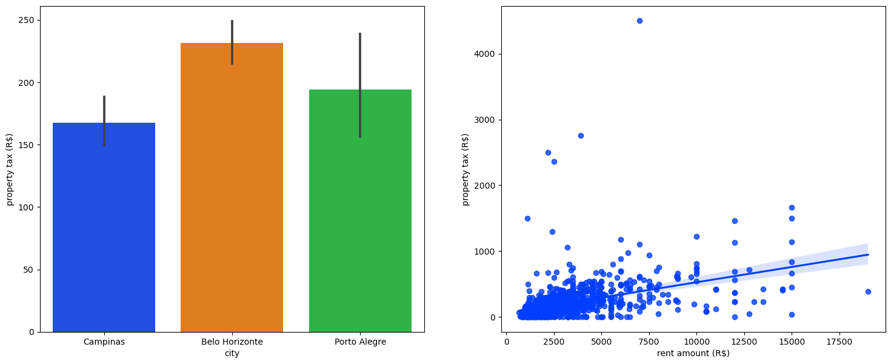
Interpretation--
On the basis of mean values of property tax amount , city campinas has the least property tax of 167 $.
Belo-horizonte has 231 $ and Porto alegre has 195 $ as propert tax to be paid.
Since property tax is increasing with the increase in rent amount , a person may want to choose a city with less tax to be paid, on that basis Campinas can be a desired city to relocate for a mid size family

Slide 11
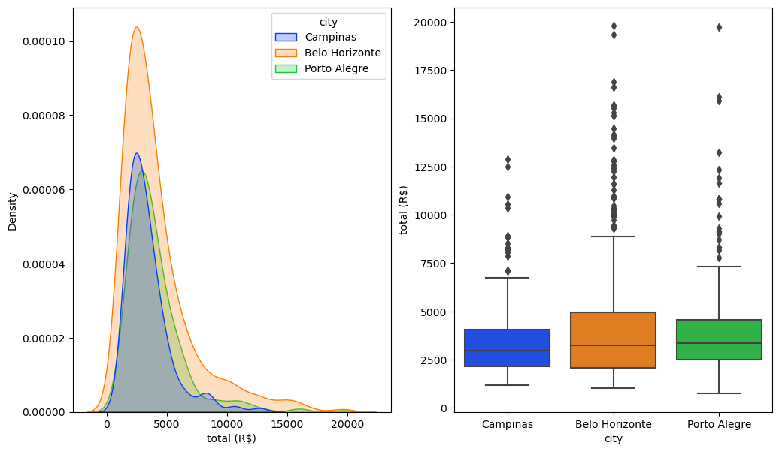
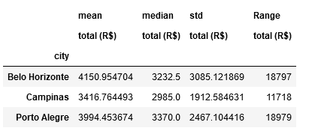
Interpretation----
Since mean >median , the data is positively skewed.
Positively Skewed means majority of the data is concerntrated on the lower end of the range and higher value of mean is due to the presence of outliers in the data .
Outlier removal is not advised as the rent of property may differ on the basis of furniture and location .
On the basis of rent amount campinas city is more preferred as compared to other cities.

Slide 12
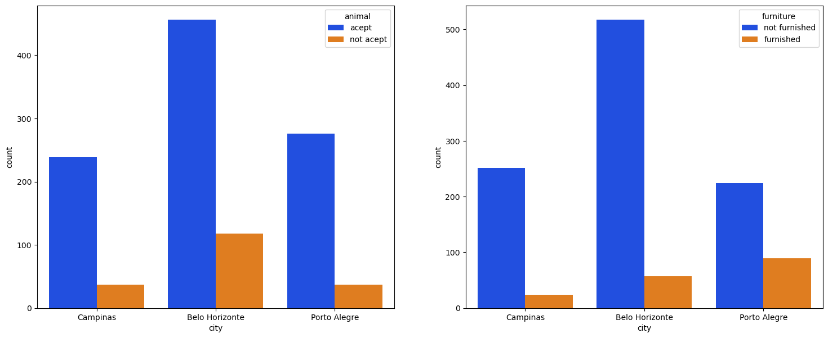
Interpretation---
On the basis of animal acceptance belo horizonte has maximum number of homes.
On the basis of furniture , belo horizonte has the maximum number of homes that are non furnished.
Conclusion---
On the basis of availability of homes , animal acceptance belo horizonte city ( 4150$ ) can be chosen, but if you want to pay less then campinas (3416 $) can be chosen by a mid-size-family to relocate.

Slide 13
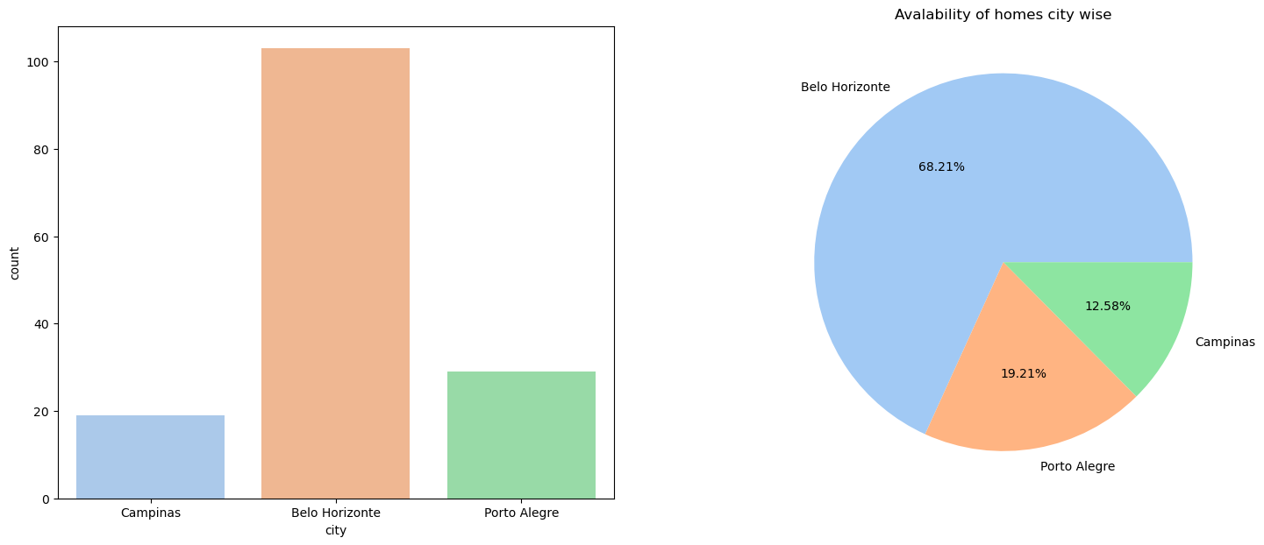
Availability Of Homes For Large Family
Criteria--- Number of rooms should be atleast 5 and bathrooms atleast 3
Interpretation----
On the basis of above criteria belo horizonte city has maximum 68.21 % homes available .

Slide 14
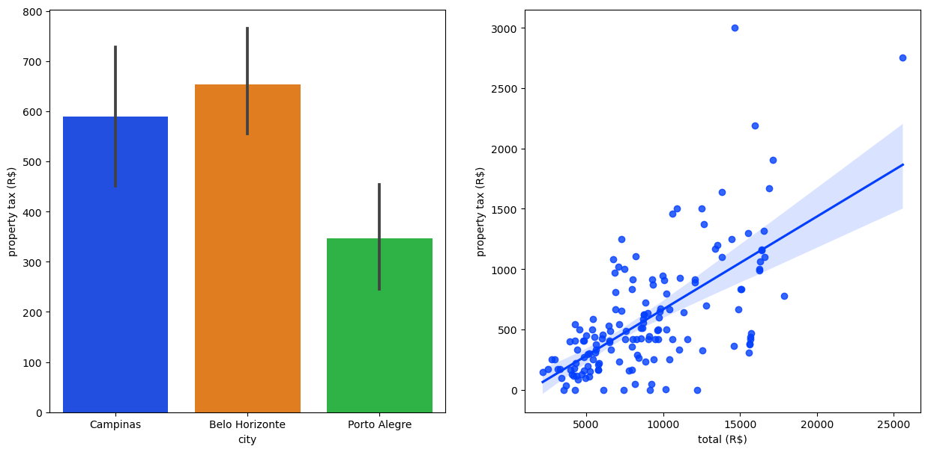
Interpretation---
On the basis of property tax, porto alegre has the least tax amount of 347 $. and belo horizonte has 654 $ as maximum amount.
With increase in rent amount there is increase in property tax.

Slide 15
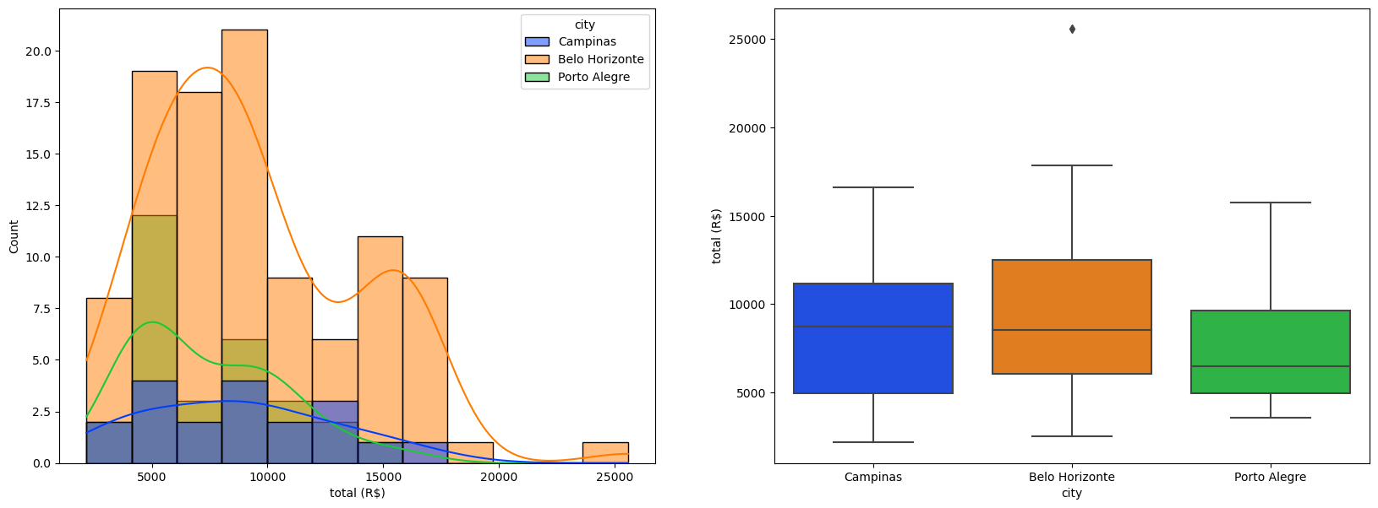
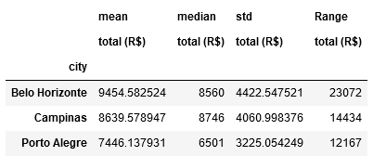
Interpretation---
The data for the total amount needs to be paid is well distributed for belo horizonte and campinas city .
For city Porto alegre the data is positively skewed.
On the basis of total amount , porto alegre city has the lowest value 7446 $ needs to paid for large family houses.
But the availablity of homes is more in belo- horizoonte city, where the avg value of total rent is 9454 $

Slide 16
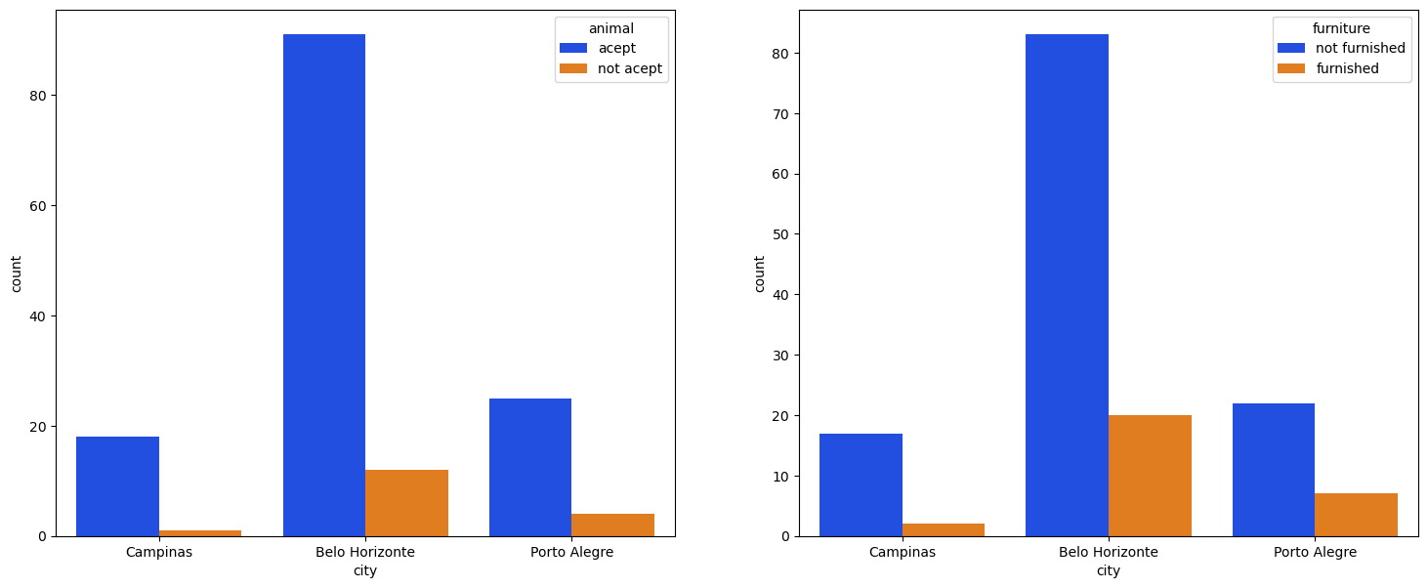
Interpretation----
On the basis of animal acceptance and total rent and availability of homes Belo horizonte city can be chosen by a large size family to relocate.
If you don’t want to pay more than porto alegre can be chosen for relocation but the number of homes here is less.

Slide 17
THANK YOU

